Slide 1
Install R
Google R and download from a US-based mirror
On command prompt of R type:
source(“http://www.customeranalyticsbook.com/install_packages.R”)
To start R Commander type:
library(“RcmdrPlugin.BCA”)

Slide 2
Chapter 3: The Data Mining Process
Notes:
bring the different styles of data mining together in one place.

Slide 3
Virtuous cycle of data mining
Identifying the problem
Transforming data into information
Taking action
Measuring the outcome

Slide 4
What can go wrong?
Learning things that aren't true.
Business decisions may be made based on incorrect information
Reliability of data mining could be deceiving
Patterns may not represent any underlying rule
e.g. Skirt length theory, bloodletting, taller men win US elections
Depend so heavily on patterns even when they are not there
Overfitting: Patterns fails to generalize the problem, unstable
It is important to have different training and validation datasets
Biased sample can seriously undermine BI efforts

Slide 5
What can go wrong? (cntd.)
Data may be at the wrong level of detail
Failure to aggregate to the appropriate level can lead to confusion
Choose a level of aggregation that does not hide important patterns within a single period
Learning Things That Are True, But Not Useful
Learning Things That Are Already Known
Learning Things That Cannot be used

Slide 6
Data Mining Styles
Hypothesis testing
Use data to answer questions or gain understanding
Directed data mining
Construct a model that explains or predicts one or more particular target variables
Undirected data mining
Find overall patterns that are not tied to a particular target

Slide 7
Hypothesis testing
A hypothesis is a proposed explanation whose validity can be tested by analyzing data.
Generating Hypotheses
Getting diverse input from throughout the organization and, where appropriate, outside it as well.
The goal is to come up with ideas that are both testable and actionable.

Slide 8
Hypothesis testing
Testing Hypotheses Using Existing Data
Test a new hypothesis by looking for evidence in existing historical data.
Testing long-held beliefs can be harder because historical data reflects whatever assumptions have been made in the past.
Small changes in what and how data is collected can greatly increase its value for analysis.

Slide 9
Hypothesis testing
Hypothesis Testing and Experimentation
Sometimes hypothesis cannot be tested on existing data
Proper experiments are necessary
Test and Control
Test group and Control group (treatments)
Choose an overall group, and then randomly divide it into the test and control group.
Any significant difference between the groups can confidently be attributed to the treatment.

Slide 10
Hypothesis testing
A/B Tests
An A/B test compares two (or possibly more) treatments
Determine the effect of even seemingly minor changes
Associated with direct marketing and web-based retailing
Paired tests
Champion/Challenger Tests
A common form of A/B testing compares a new treatment, the challenger, with the existing treatment, the champion.
The new model should not be adopted until it is shown to be better than the old one.
Case Study about recommender systems in Hypothesis Testing: Measuring the Wrong Thing

Slide 11
Directed Data Mining
Focuses on one or more variables that are targets, and the historical data contains examples of all the target values.
Looks for patterns that explain the target values
Predictive modeling
is specifically used when the target comes from a timeframe later than the inputs;
Profile modeling
is specifically used when the target and inputs come from the same timeframe.

Slide 12
Undirected Data Mining
The goal is to find overall patterns. After patterns have been detected, it is the responsibility of a person to interpret them and decide whether they are useful.
Although no target variable is used, business goals must still be addressed.
Sometimes, the business goals themselves may be a bit vague and the data mining effort is a way to refine them.

Slide 13
Goals, Tasks, and Techniques
Find a business goal
Get a good understanding of that goal.
Require good communication between people in upper management who set the goals and the analysts responsible for translating those goals into data mining tasks.
Restate the business goal in terms of data mining tasks
Select particular data mining techniques

Slide 14
Data Mining Business Goals
The business goal should be well-defined and directed towards particular efforts that are amenable to analysis using available data.
A data mining business goal can usually be expressed in terms of something measurable such as incremental revenue, response rate, order size, or wait time.

Slide 15
Data Mining Tasks
Data mining tasks are technical activities that can be described independently of any particular business goal.
Preparing data for mining
Exploratory data analysis (EDA)
Binary response modeling
Classification of discrete values and predictions
Estimation of numeric values
Finding clusters and associations
Applying a model to new data

Slide 16
Data Mining Tasks
Preparing data for mining
Some data preparation is required to fix problems with the source data, but much of it is designed to enhance the information content of the data.
Some data mining techniques cannot handle missing values, so missing values must somehow be dealt with
Data preparation may involve creating new variables

Slide 17
Data Mining Tasks
Exploratory Data Analysis
Report or a collection of graphs that describe something of interest.
Add new measures and variables in the data.
Profiling is a familiar approach to many problems
With behavioral data, the direction of causality is not always so clear.
Eg men & beer; inverse relation in money in savings & FDs;

Slide 18
Data Mining Tasks
Binary Response Modeling (Binary Classification)
Many business goals boil down to separating two categories from each other
Classification
Classification consists of assigning a newly presented object to one of a set of predefined classes.
The task is to build a model of some kind that can be applied to unclassified data in order to classify it.

Slide 19
Data Mining Tasks
Estimation
Estimation deals with continuously valued outcomes.
income, order size, credit card balance, propensity to accept an offer, time of next purchase
Finding Clusters, Associations, and Affinity Groups
Affinity grouping is one simple approach to generating rules from data.
Clustering is the task of segmenting a heterogeneous population into a number of more homogeneous subgroups or clusters.
In clustering, there are no predefined classes and no examples.
Clustering is often a prelude to some other form of data mining or modeling.

Slide 20
Data Mining Tasks
Applying a model to new data
For binary response modeling, classification, and estimation, the data used to create the model contains known values of the target variable.
Purpose is to score new data where the probability of response, class, or value to be estimated is unknown.
Applying a model to new data is called scoring.
The result of scoring is a new table with at least two columns — the identifier and the score.

Slide 21
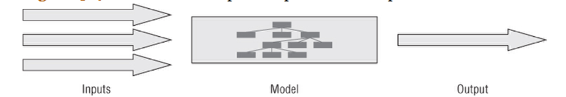
Data Mining Techniques
Data mining is accomplished by building models.
A model is something that uses data to classify things, make predictions, estimate values, or to produce some other useful result.

Slide 22
Data Mining Techniques
Two purposes of data mining models:
Produce scores that you can use to guide decisions.
Provide insight into the relationship between the explanatory variables used to build the model and the target.
Two categories of Data mining techniques :
Directed and undirected techniques, whether techniques themselves require target variables

Slide 23
Formulating Data Mining Problems: From Goals to Tasks to Techniques
Choosing the Best Places to Advertise
Profile existing profitable customers using demographic and geographic characteristics such as age, sex, occupation, marital status, and neighborhood characteristics. Use this profile to define the prototypical profitable customer.
Define the audience of each potential advertising vehicle using the same variables used to profile profitable customers.
Estimate the distance from each advertising channel to the prototypical profitable customer. This distance is the advertising channel's similarity score; as in golf, smaller is better.
Advertise in the venues with the lowest scores.

Slide 24
Formulating Data Mining Problems: From Goals to Tasks to Techniques
Determining the best product to offer a customer
For each product, build a binary response model to estimate the propensity of customers for the product.
Set the propensity score to 0 for customers who already have a product.
Using the propensity scores, design a decision procedure that assigns the best product to each customer, based on something like the highest propensity or the highest expected profit.

Slide 25
Formulating Data Mining Problems: From Goals to Tasks to Techniques
Finding the best locations for branches or stores
Build a model to estimate some store performance metric based on the available explanatory variables for the catchment area.
Apply the model to candidate locations so the highest scoring locations can be selected.
An alternative approach is to classify the stores as good, medium, bad; ignore medium category; and then build a model that predicts good & bad; next apply model to classify.

Slide 26
Formulating Data Mining Problems: From Goals to Tasks to Techniques
Segmenting Customers on Future Profitability
Prepare the data for modeling by turning the clock back one year and taking a snapshot of each customer who was active on that date. Then, measure the total revenue during the following year. This creates a prediction model set.
Use this model set to estimate how much someone will be worth in the next year.
Segment the anticipated revenue into thirds, to get high, medium, and low anticipated revenue.

Slide 27
Formulating Data Mining Problems: From Goals to Tasks to Techniques
Decreasing Exposure to Risk of Default
A binary response model could be built using a variety of techniques, such as logistic regression, decision trees, or neural networks.
Undirected techniques, such as clustering, could even be used.
Combines the probability of default with the amount of default. This two-stage model estimates how much a customer would owe after defaulting.
Treat this as a time-to-event problem, estimating when a customer is likely to default.

Slide 28
Formulating Data Mining Problems: From Goals to Tasks to Techniques
Improving Customer Retention
Find customers most at risk of leaving and encourage them to stay.
Quantify the value of improving operations, so customers will stick around.
Determine which methods of acquiring customers bring in better customers.
Determine which customers are unprofitable, and let them leave.

Slide 29
Formulating Data Mining Problems: From Goals to Tasks to Techniques
Detecting Fraudulent Claims
Directed data mining task:
Build a profiling model that is capable of distinguishing fraudulent claims from legitimate ones.
Use the model to score all claims that come in. Mark claims that score higher than some threshold for additional scrutiny before approval.
Undirected data mining:
Form clusters of similar claims. Most claims will probably fall into a few large clusters representing different types of legitimate claim.
Examine the smaller clusters to see what makes them special.

Slide 30
Case study: one goal, 2 tasks
Objective: Maximize donations to charity
The more donations one make, the lesser total money one donates
Decision of donation seems to be separate from how big a donation is made
2 models:
Response model to identify who would donate
Estimation model to predict the size of donation
Alternative, one estimation model including those who didn’t donate. 2 step model turned out to give better estimations.

Slide 31
Summary
What Techniques for Which Tasks?
Is There a Target or Targets?
What Is the Target Data Like?
What Is the Input Data Like?
How Important Is Ease of Use?
How Important Is Model Explicability?

Slide 32
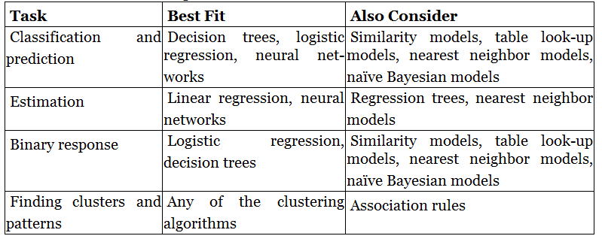
Summary

